Slide 1

2016 and 2020 Summer Olympic Data
Blake davis – DSCI 235

Slide 2
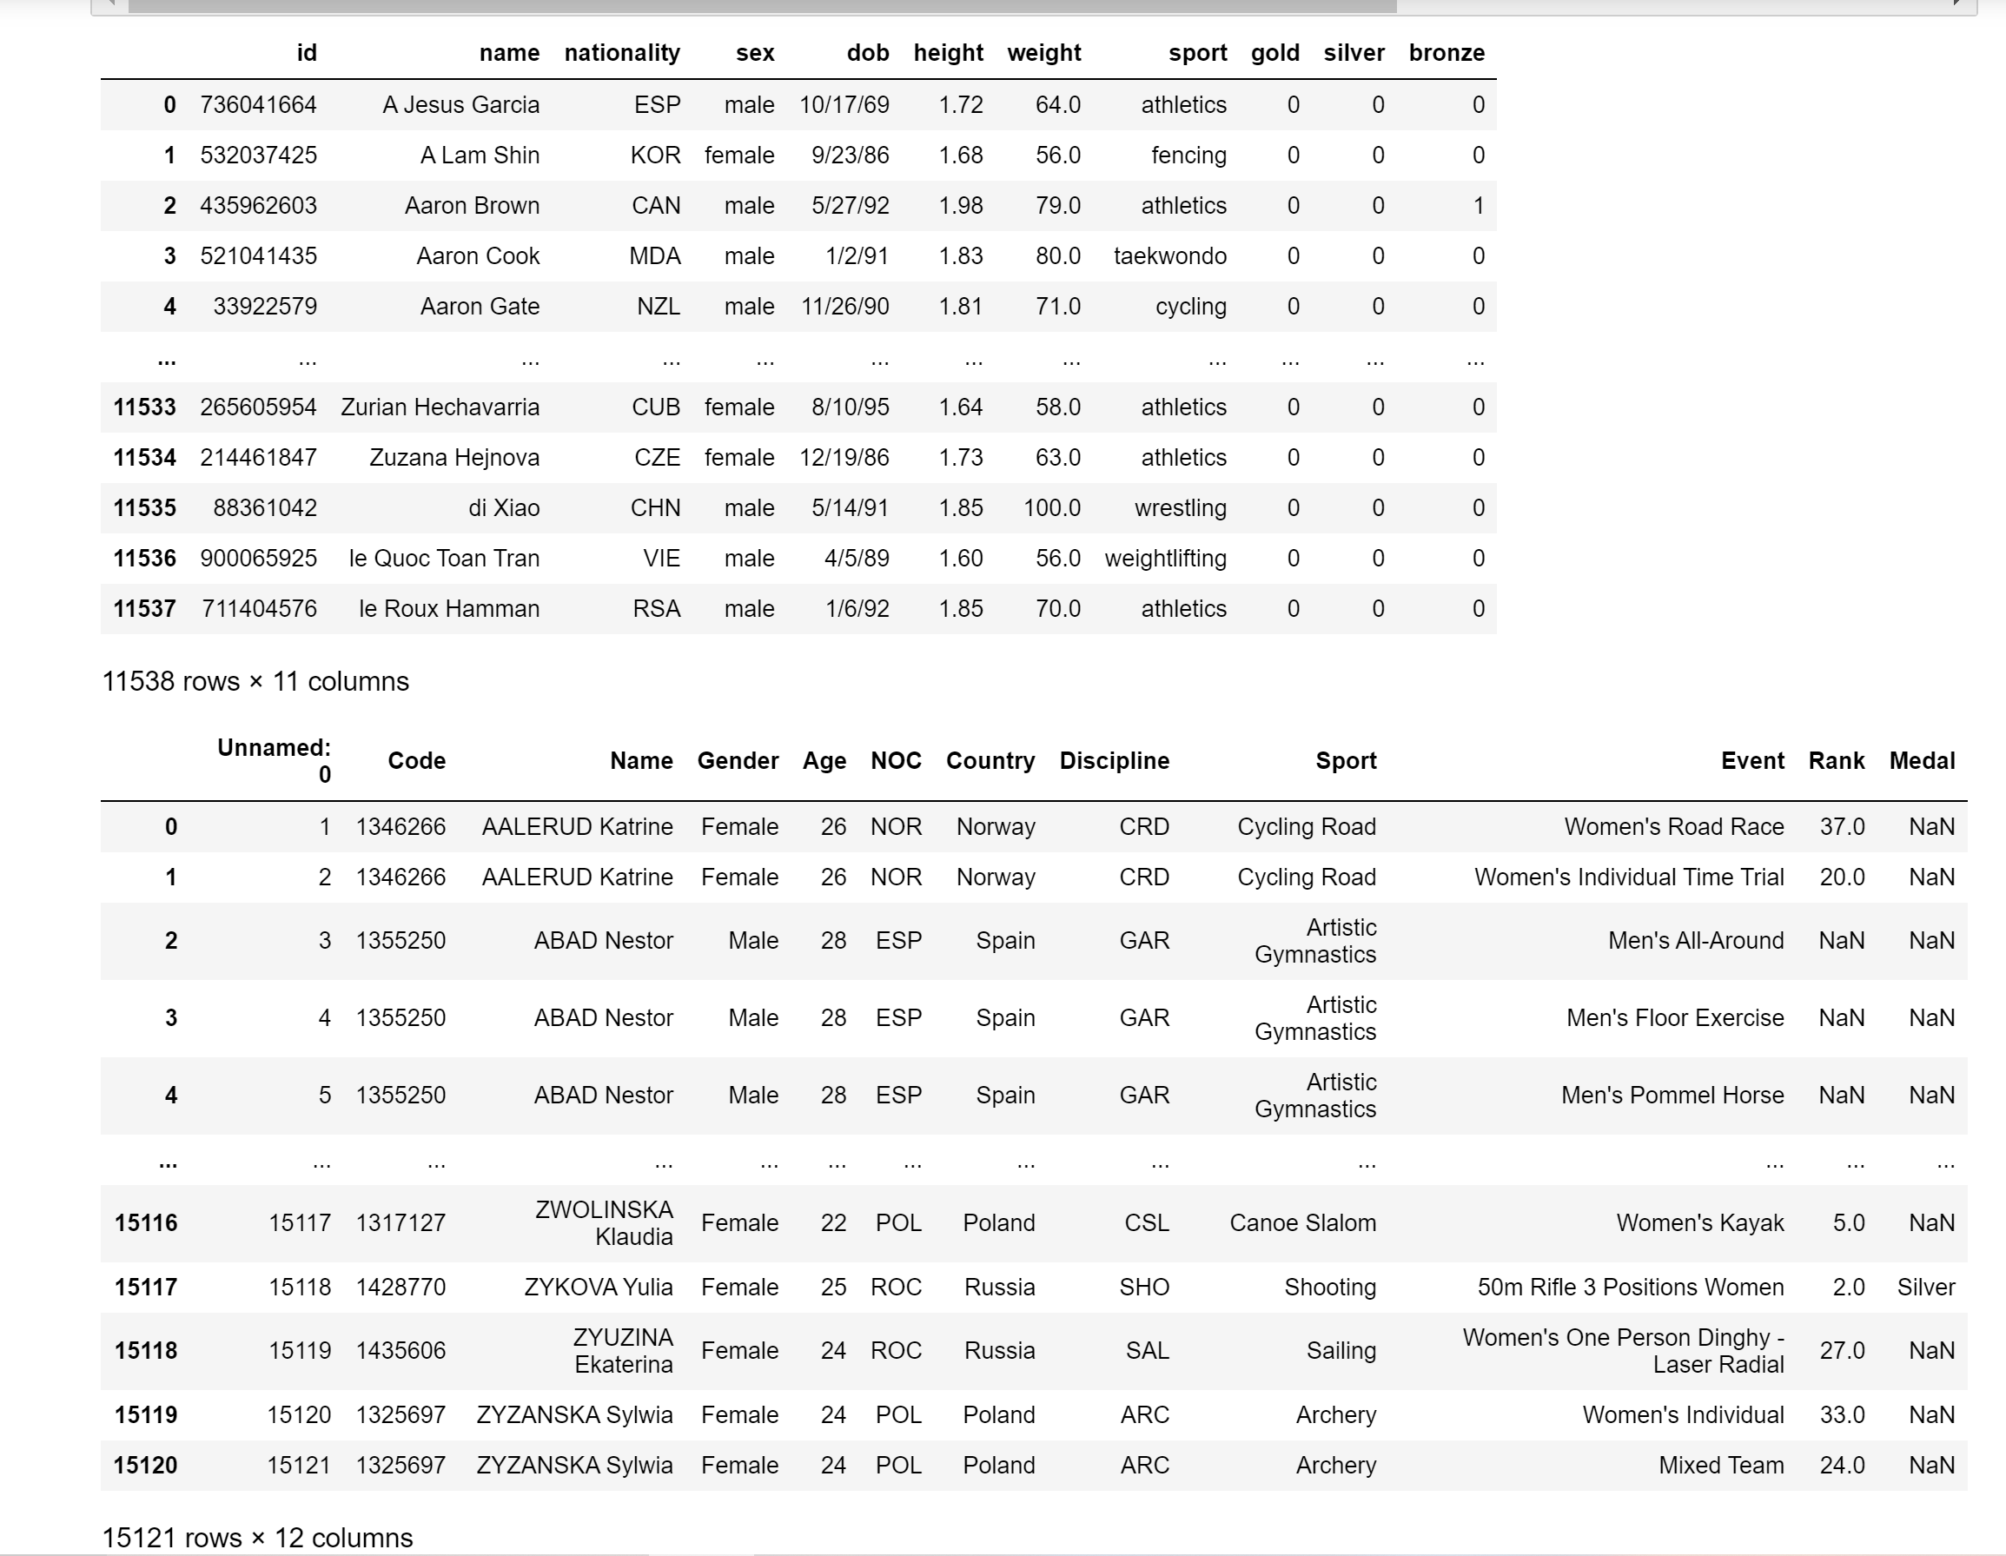
My Datasets

Slide 3
The Questions I Wanted to Answer
1. What is the average age of an Olympic athlete in 2016? 2020? Compare.
- Which events have a mean age greather than 30? Which events have a mean age greather than 28?<br>
2. Who are the 5 oldest athletes and who are the 5 youngest athletes in 2016 and 2020?
- What country are they from? <br>
- What sport do they compete in? <br>
- What does the age distribution of their sport in 2016 and 2020 look like, if available? <br>
- Do any of them compete in the events that tend to have younger or older competitors, respectively? <br>
3. Which Olympic athlete has the most medals in 2016? <br>
4. What are the top medaling countries in 2016? 2020? Compare.
5. Does the United States have more female or male medalists in 2020?
- What is the average age of United States Male Medalists? Of United States Female Medalists? Of All United States Medalists?

Slide 4
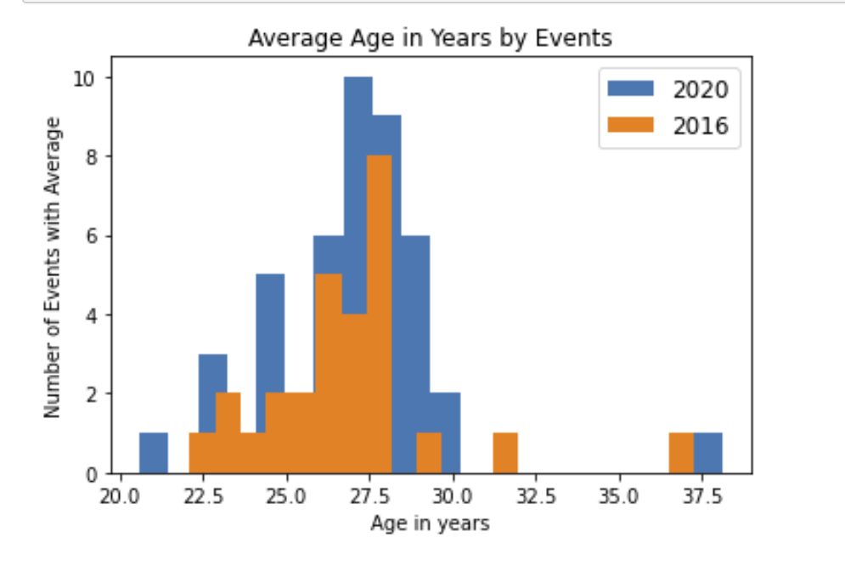
Mean Age

Slide 5
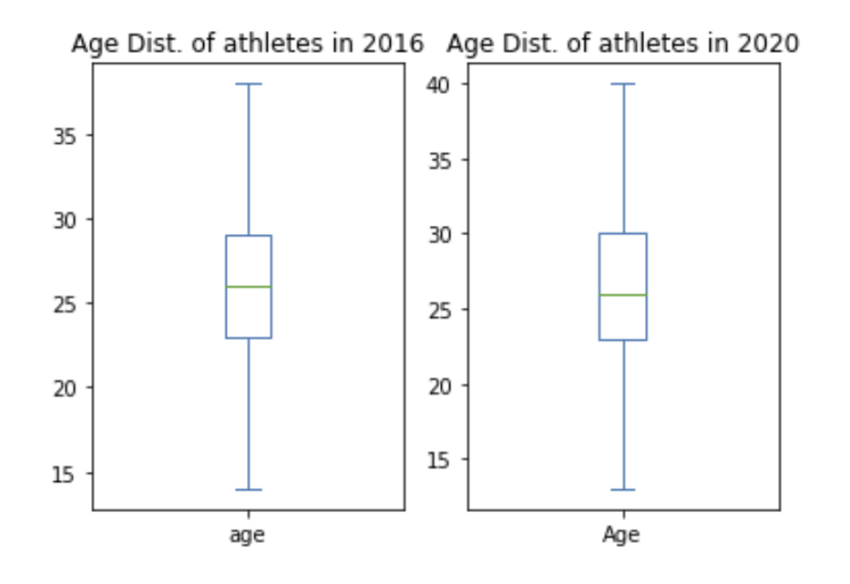
Age Distribution

Slide 6
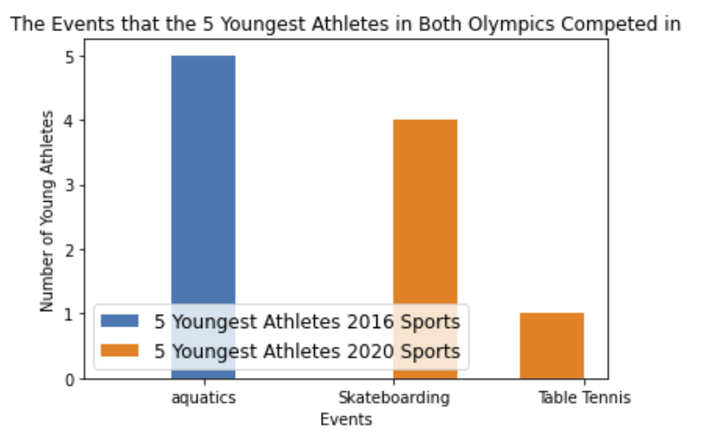
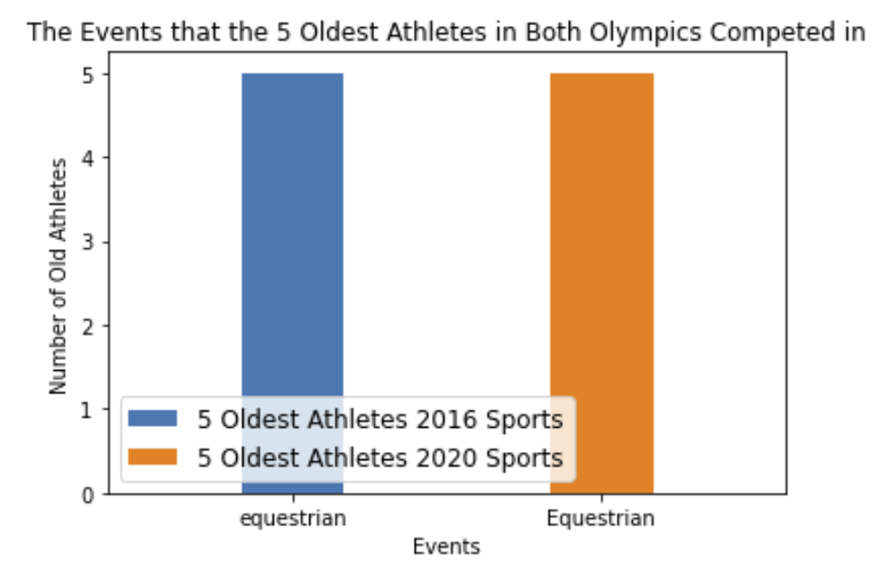
Young and Old Competitors

Slide 7
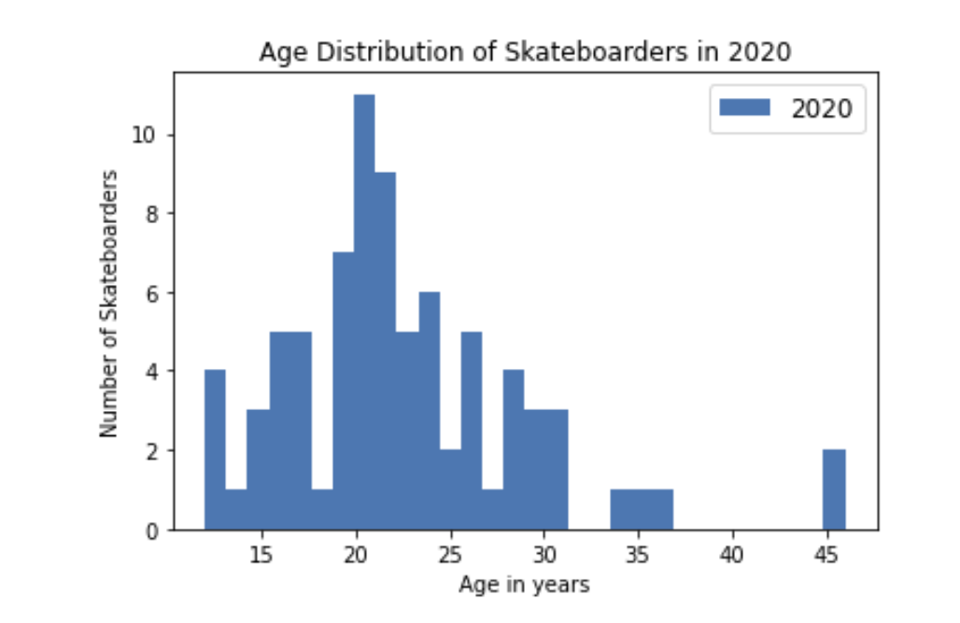
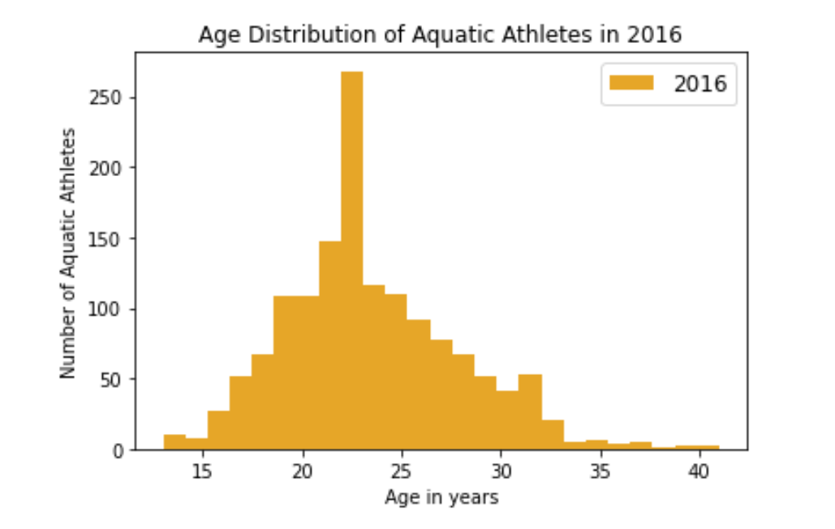
Aquatic Athletes and Equestrians

Slide 8
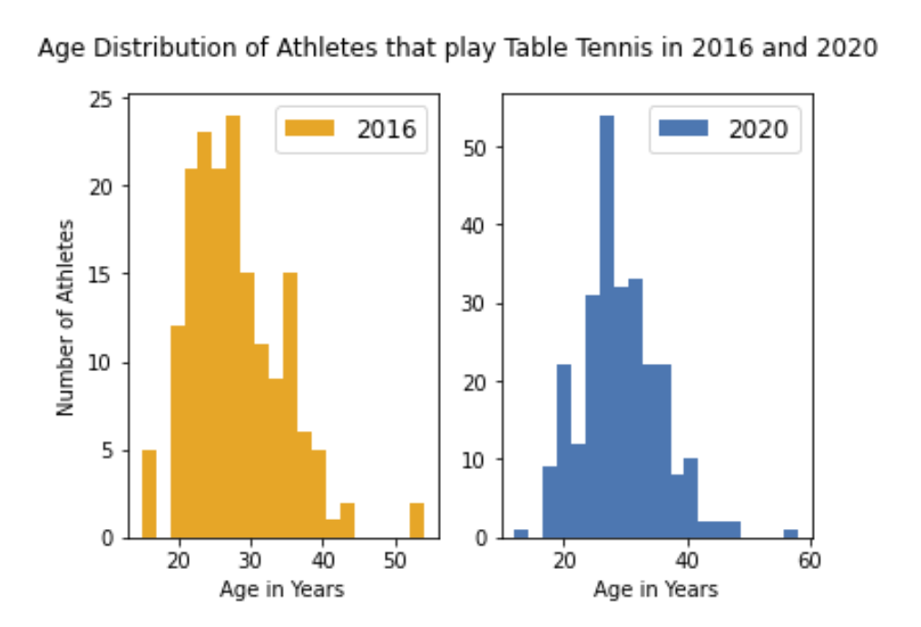
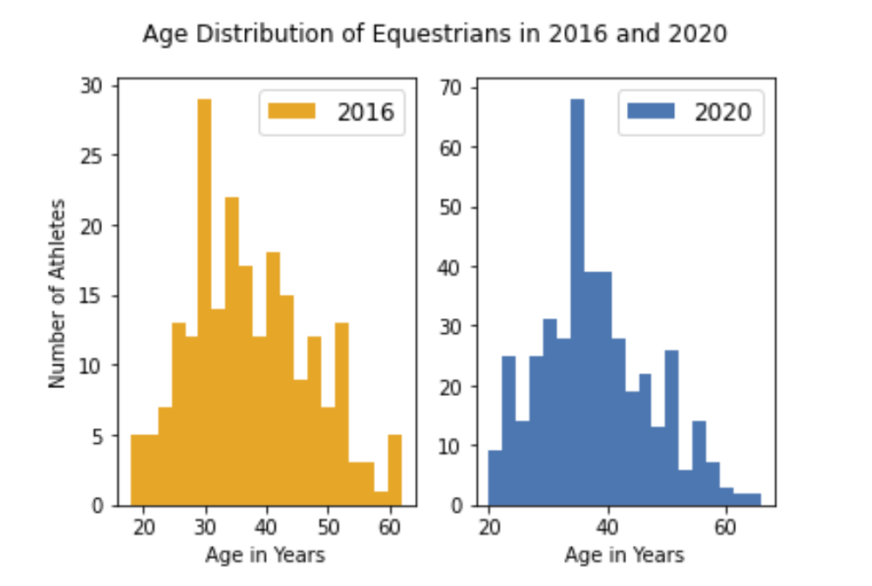
Athletes that play Table Tennis and Equestrians

Slide 9
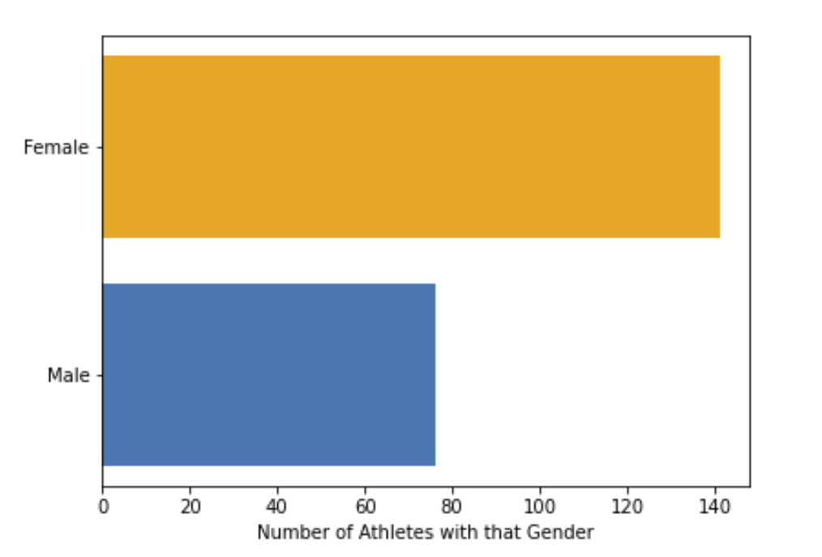
Does the US have more female or male medalists in 2020?

